Slide 2
AI and Vector Data Extensions
The AI and Vector Data Extensions are a set of .NET libraries that offer shared abstractions and utilities for working with AI models and vector stores.
Notes:
https://devblogs.microsoft.com/dotnet/ai-vector-data-dotnet-extensions-ga/

Slide 3
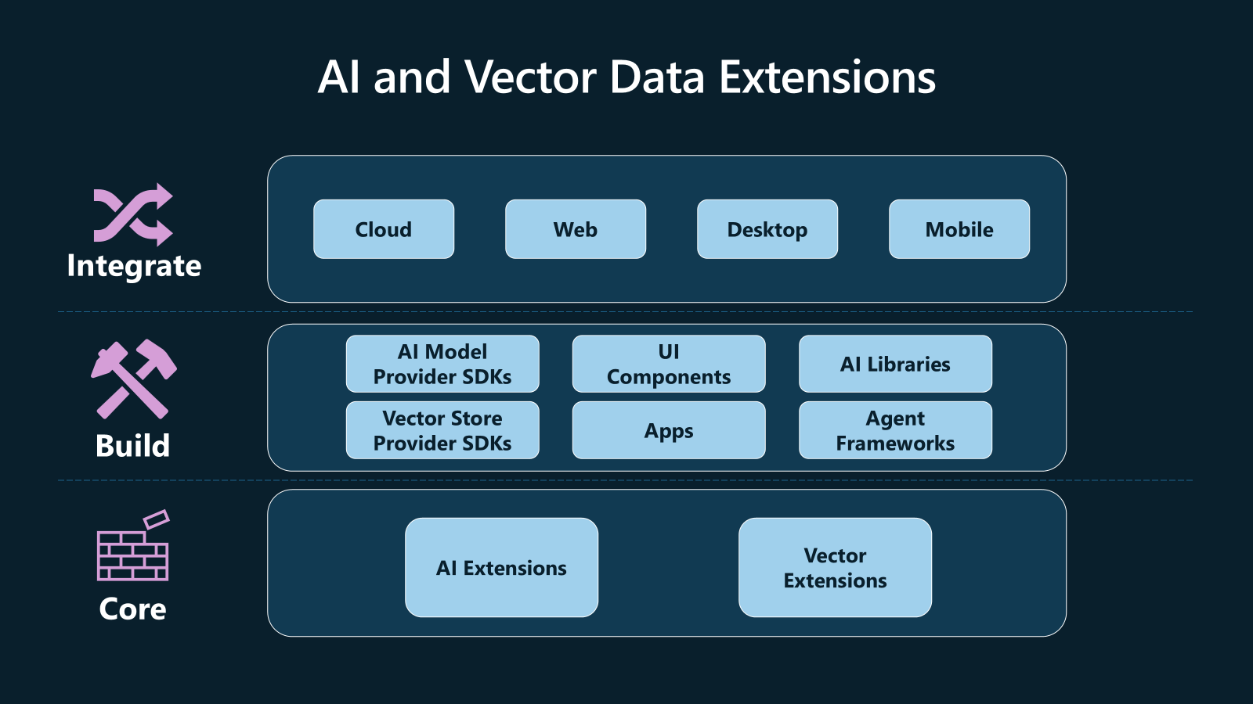
AI and Vector Data Extensions

Slide 4
Microsoft.Extensions.AI
A set of core .NET libraries developed in collaboration with developers across the .NET ecosystem, including Semantic Kernel.
These libraries provide a unified layer of C# abstractions for interacting with AI services, such as small and large language models (SLMs and LLMs), embeddings, and middleware.
Notes:
https://devblogs.microsoft.com/dotnet/introducing-microsoft-extensions-ai-preview/
https://learn.microsoft.com/en-us/dotnet/ai/microsoft-extensions-ai

Slide 5
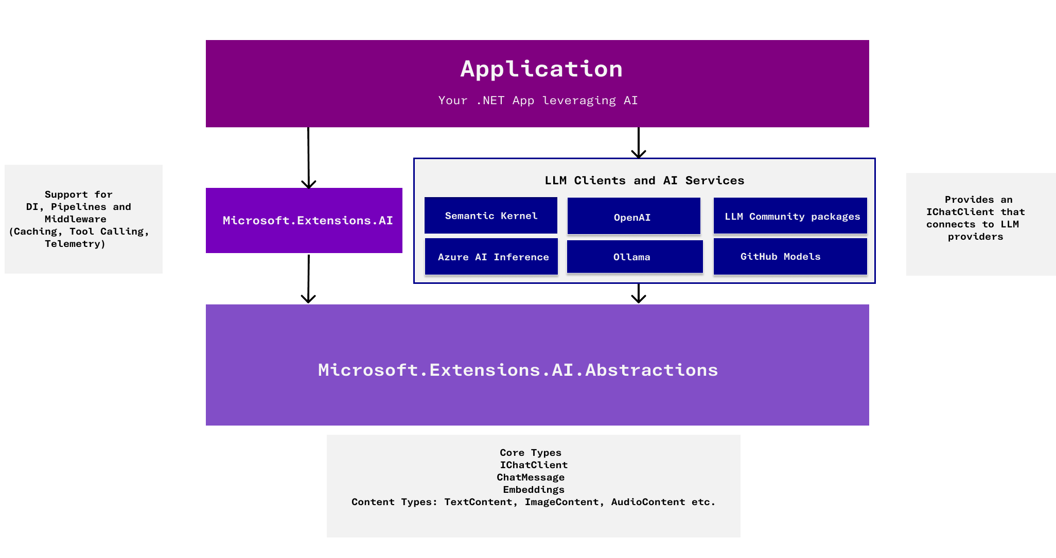
Microsoft.Extensions.AI

Slide 6
Microsoft.Extensions.VectorData
A set of core .NET libraries developed in collaboration with Semantic Kernel and the broader .NET ecosystem.
These libraries provide a unified layer of C# abstractions for interacting with vector stores.
Perform Create-Read-Update-Delete (CRUD) operations on vector stores.
Use vector and text search on vector stores.
Notes:
https://devblogs.microsoft.com/dotnet/introducing-microsoft-extensions-vector-data/

Slide 7
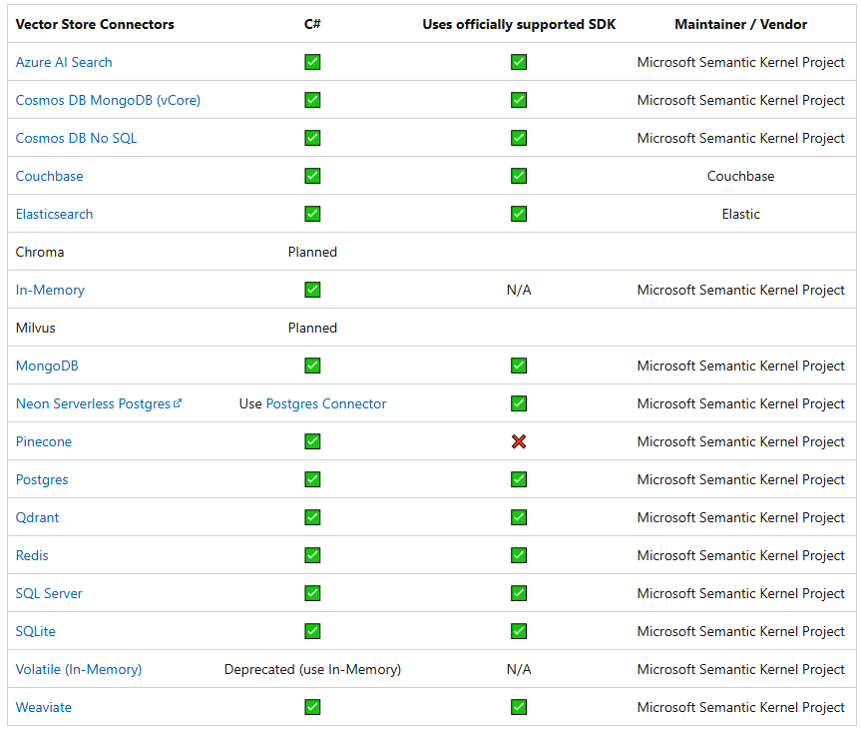
Vector Store connectors
Notes:
https://learn.microsoft.com/en-us/semantic-kernel/concepts/vector-store-connectors/out-of-the-box-connectors/?pivots=programming-language-csharp

Slide 8
EF Core Vector Supports
Azure Cosmos DB
Azure SQL/ SQL Server 2025
PostgreSQL
Notes:
https://learn.microsoft.com/en-us/semantic-kernel/concepts/vector-store-connectors/out-of-the-box-connectors/?pivots=programming-language-csharp

